Slide 1
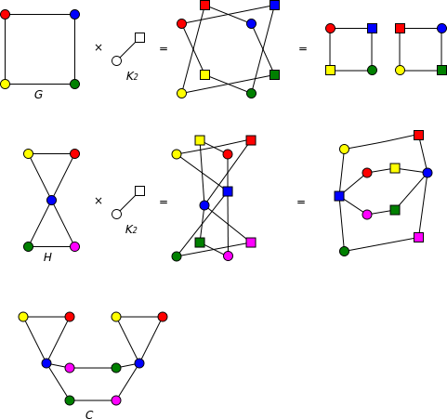
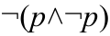
Coverage
Literature of software testing is primarily concerned with various notions of coverage
Four basic kinds of coverage:
Graph coverage
Logic coverage
Input space partitioning
Syntax-based coverage
Two purposes: to know what we have & haven’t tested, and to know when we can “safely” stop testing

Slide 2
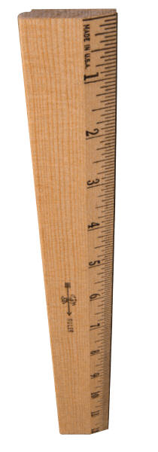
Need to Abstract Testing
As we have seen, we can’t try all possible executions of a program
How can we measure “how much testing” we have done and look for more things to test?
Could talk about modules we have and have not tested, or use cases explored
Could also talk structurally – what aspects of the source code have we tested?

Slide 3
Graph Coverage
Cover all the nodes, edges, or paths of some graph related to the program
Examples:
Statement coverage
Branch coverage
Path coverage
Data flow (def-use) coverage
Model-based testing coverage
Many more – most common kind of coverage, by far

Slide 4
Statement/Basic Block Coverage
if (x < y)
{
y = 0;
x = x + 1;
}
else
{
x = y;
}
Statement coverage: Cover every node of these graphs
1
x < y
x >= y
y = 0
x = x + 1
2
3
x = y
4
if (x < y)
{
y = 0;
x = x + 1;
}
1
x < y
Treat as one node because if one statement executes the other must also execute (code is a basic block)
y = 0
x = x + 1
x >= y
2
3

Slide 5
Branch Coverage
if (x < y)
{
y = 0;
x = x + 1;
}
else
{
x = y;
}
Branch coverage vs. statement coverage: Same for if-then-else
1
x < y
x >= y
y = 0
x = x + 1
2
3
x = y
4
if (x < y)
{
y = 0;
x = x + 1;
}
1
But consider this if-then structure. For branch coverage can’t just cover all nodes, but must cover all edges – get to node 3 both after 2 and without executing 2!
x < y
y = 0
x = x + 1
2
x >= y
3

Slide 6
Path Coverage
How many paths through this code are there? Need one test case for each to get path coverage
if (x < y)
{
y = 0;
x = x + 1;
}
else
{
x = y;
}
if (x < y)
{
y = 0;
x = x + 1;
}
1
x < y
x >= y
To get statement and branch coverage, we only need two test cases:
1 2 4 5 6 and 1 3 4 6
y = 0
x = x + 1
2
3
x = y
4
4
Path coverage needs two more:
1 2 4 5 6
1 3 4 6
1 2 4 6
1 3 4 5 6
x < y
y = 0
x = x + 1
5
x >= y
6
In general: exponential in the number of conditional branches!

Slide 7
Data Flow (Def-Use) Coverage
1
x = 3;
y = 3;
if (w) {
x = y + 2;
}
if (z) {
y = x – 2;
}
n = x + y
x = 3
Def(x)
Annotate program with locations where variables are defined and used (very basic static analysis)
2
y = 3
Def(y)
3
w
Def-use pair coverage requires executing all possible pairs of nodes where a variable is first defined and then used, without any intervening re-definitions
x = y + 2
4
!w
Def(x)
Use(y)
5
4
z
!z
E.g., this path covers the pair where x is defined at 1 and used at 7: 1 2 3 5 6 7
y = x - 2
6
Def(y)
Use(x)
May be many pairs, some not actually executable
7
But this path does NOT: 1 2 3 4 5 6 7
n = x + y
Use(x)
Use(y)
Notes:
Def means we write, Use means we use…

Slide 8
Logic Coverage
What if, instead of:
if (x < y)
{
y = 0;
x = x + 1;
}
1
((a>b) || G)) && (x < y)
y = 0
x = x + 1
2
((a <= b) && !G) || (x >= y)
we have:
3
if (((a>b) || G)) && (x < y))
{
y = 0;
x = x + 1;
}
Now, branch coverage will guarantee that we cover all the edges, but does not guarantee we will do so for all the different logical reasons
We want to test the logic of the guard of the if statement

Slide 9
Active Clause Coverage
( (a > b) or G ) and (x < y)
1 T F T T
2 F F T F
With these values for G and (x<y), (a>b) determines the value of the predicate
With these values for (a>b) and (x<y), G determines the value of the predicate
3 F T T T
4 F F T F
duplicate
With these values for (a>b) and G, (x<y) determines the value of the predicate
5 T T T T
6 T T F F
9

Slide 10
Input Domain Partitioning
Partition scheme q of domain D
The partition q defines a set of blocks, Bq = b₁ , b₂ , … b_{Q}
The partition must satisfy two properties:
blocks must be pairwise disjoint (no overlap)
together the blocks cover the domain D (complete)
Coverage then means using at least one input from each of b₁, b₂, b₃, . . .
10

Slide 11
Syntax-Based Coverage
Usually known as mutant testing
Bit different kind of creature than the other coverages we’ve looked at
Idea: generate many syntactic mutants of the original program
Coverage: how many mutants does a test suite kill (detect)?
11

Slide 12

Syntax-Based Coverage
MUTANTS OF P
Program P
P
100% coverage means you kill all the mutants with your test suite
12

